Slide 1


Welcome

Slide 2



Name:
Faculty:
Ahmed Mahmoud Ahmed Abdeltwab
Computer and Information Sciences
Course:
Instructor:
ITI_Python_ALL_23
Kamal Radwan

Slide 3

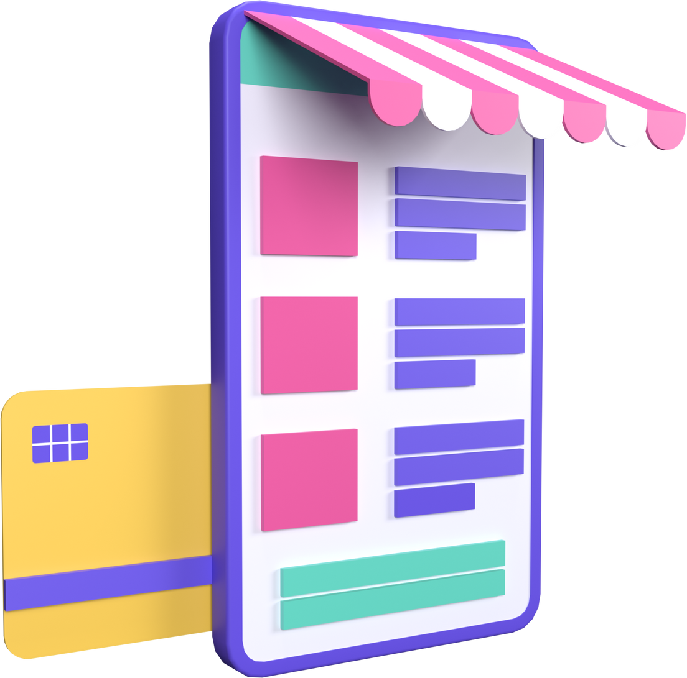
TABLE OF CONTENT
INTRODUCTION
PROJECT
FEATURES
TOOLS USED
FUTURE WORK
E-COMMERCE ADVANTAGES
E-COMMERCE DISADVANTAGES
UML DIAGRAMS
Back-end
USER INTERFACE
CONTACTS

Slide 4




PROJECT
Project Name:
Project Description:
Project Goals:
DEEDA
Deeda is the new image of Just Collection Company for producing fashion ladies’ handbags which was founded in 1995, as a specialized bag designer and manufacturer.
We offer the widest selection of high quality, fashionable handbags at competitive prices.
Deeda offers you high quality bags through a long development history, high efficient industrial cluster, professional production, skilled workers and advanced equipment.
All our accessories are imported with the latest trends and best quality.

Slide 5










FEATURES
Home
Product
Cart
Registration
UX
Slider section, image gallery, navigation bar, and search bar.
Displaying multiple images for the product along side with all information.
Calculate all the user’s desired products prices and proceed to check-out.
Afford a secured way of dealing with platform.
Easy navigation, increased performance, and wonderful design.

Slide 6
LANGUAGES USED
01
HTML
01
02
03
04
05
02
CSS
03
JavaScript
04
SQL
05
Python

Slide 7







TOOLS USED
VSCode
XAMPP
Django

Slide 8




FUTURE WORK
01
Try to develop a more fascinating design
02
Increase the performance and develop more suitable database
03
Trying to host the site and get more traffic
03
02
01

Slide 9




INTRODUCTION
Definition: Ecommerce, short for electronic commerce, is the buying and selling of goods or services online.
Process: It involves conducting commercial transactions through websites, mobile apps, or other online marketplaces. Ecommerce enables businesses to reach a global audience, streamline operations, and provide customers with convenient online shopping experiences.

Slide 10

ADVANTAGES
LOW COSTS
Opening a store is expensive. You have to pay rent, furnish the space, get the equipment you need, and hire employees to work in it.
DATA
In 2023, data is mastering. All of the websites we use every day collect tons of data about us to learn how we surf the web.
FLEXIBILITY AND SPEED
Opening a brick and mortar store takes time.

Slide 11

DISADVANTAGES
The Website Is All You Have
you never get a second chance to make a good first impression. Yours, as an online vendor, is your business’s website.
Navigation
Your goal is a pleasant experience for all your visitors, with ease of navigation. If your customers come to your site and can’t use it easily, or can’t locate what they’re looking for, you’ve lost a sale.
STABILITY
Your site needs to be stable – that means it doesn’t crash or take forever to load.

Slide 12


DISADVANTAGES
SECURITY
Data breaches and hacks have made the news a lot lately.
CREDIBILITY
No matter what industry or market you’re in, business is about people and relationships. Creating those relationships can be more challenging in the ecommerce world

Slide 13
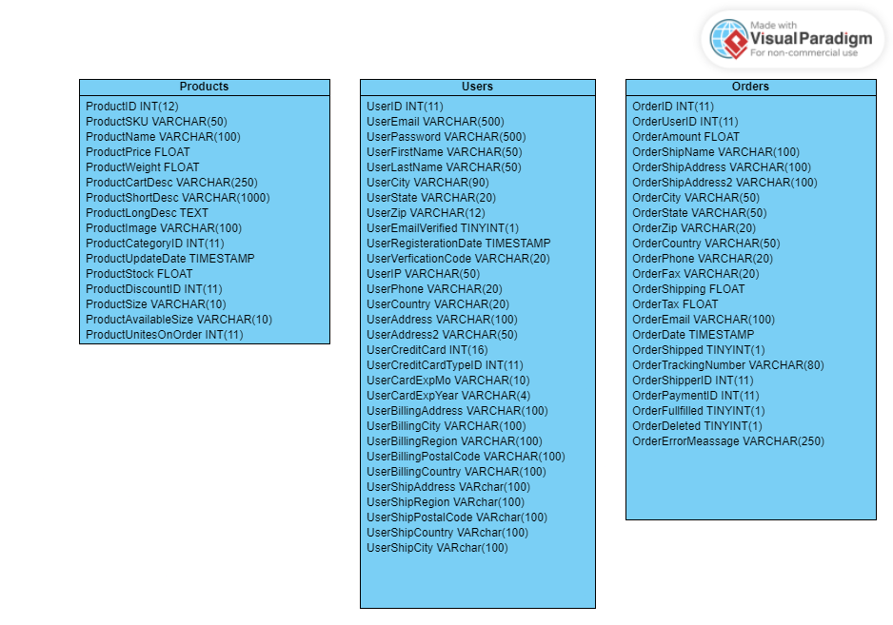
UML CLASS DIAGRAM

Slide 14
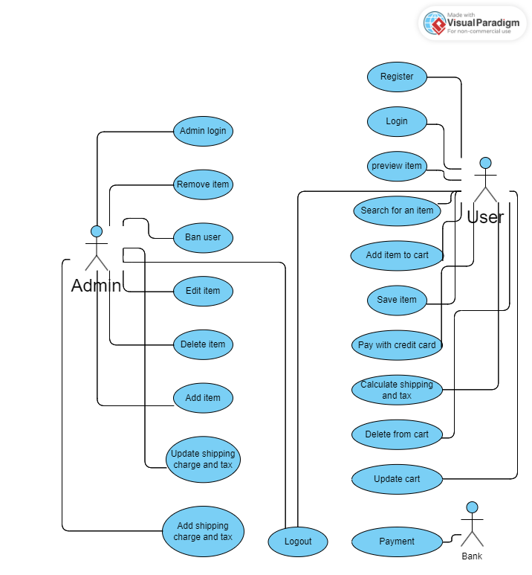
UML USE CASE DIAGRAM

Slide 15

BACK-END

Slide 16
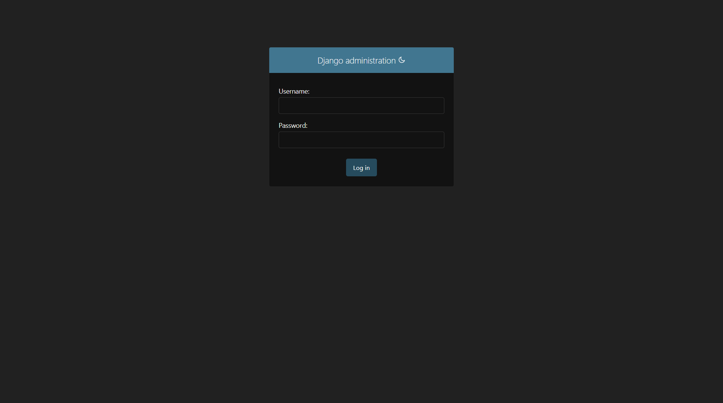
ADMIN PAGE

Slide 17
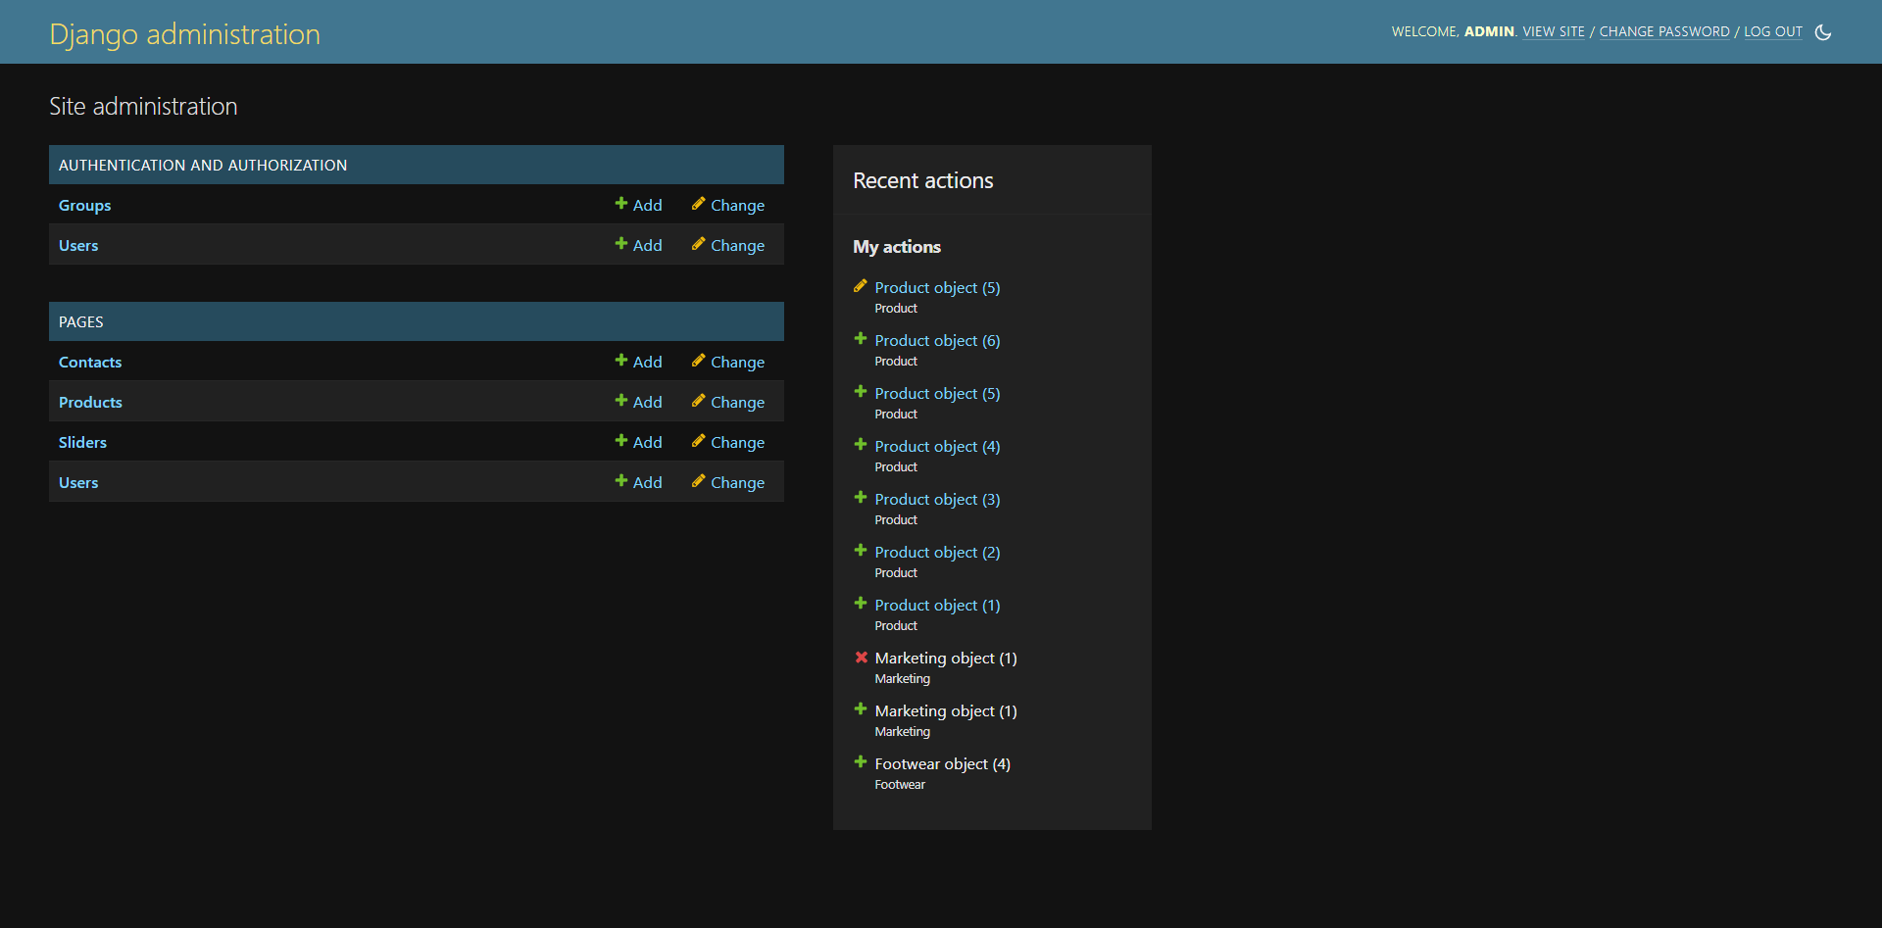
DATABASE

Slide 18
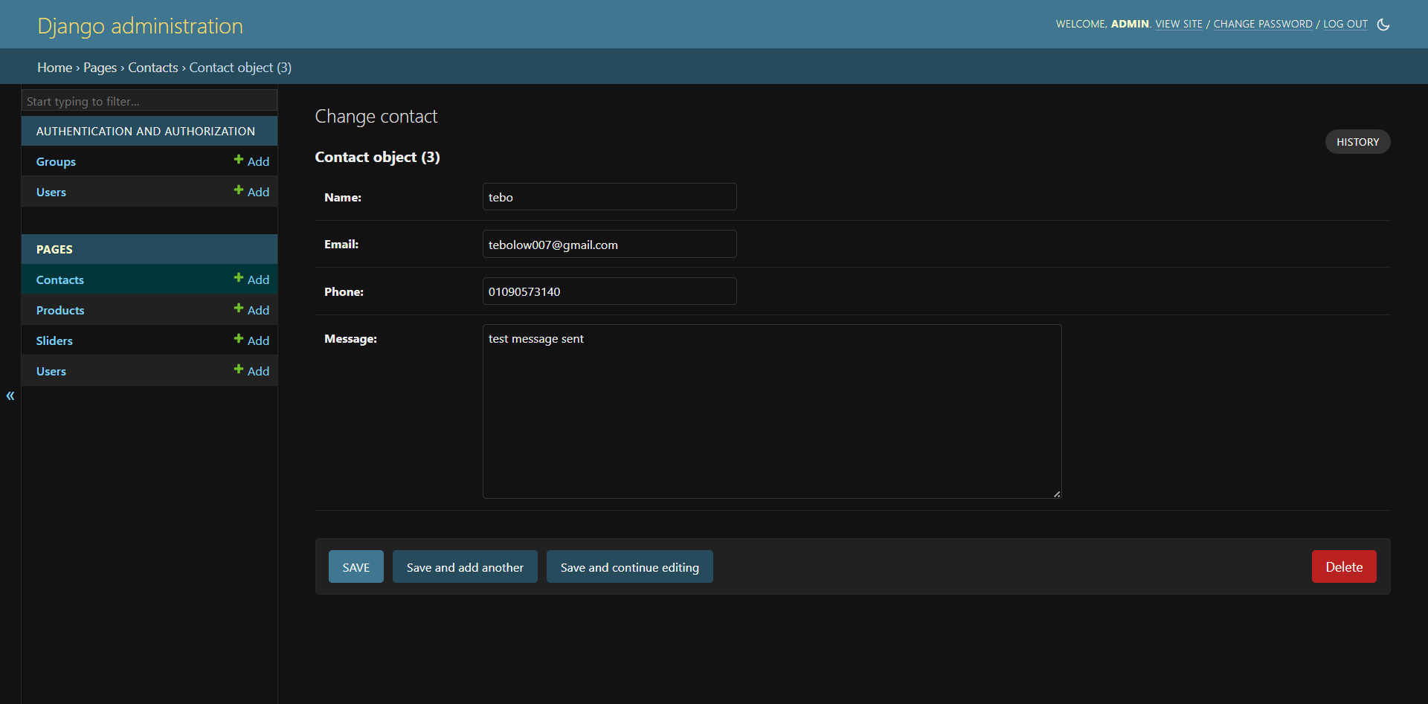
CONTACTS TABLE

Slide 19
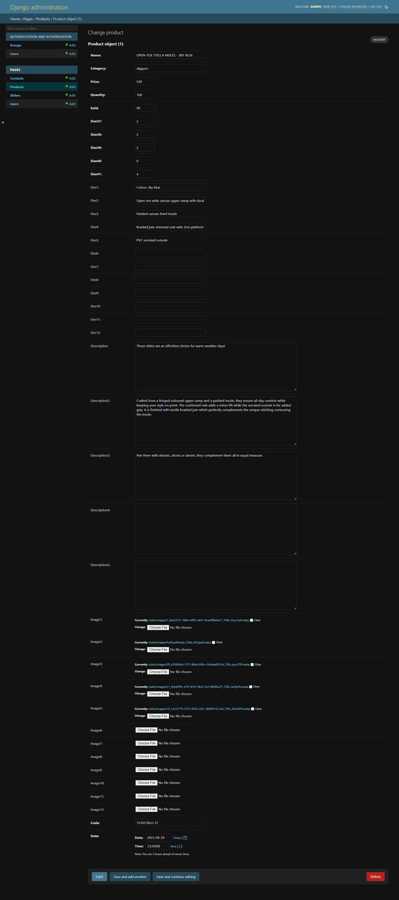
PRODUCT TABLE

Slide 20
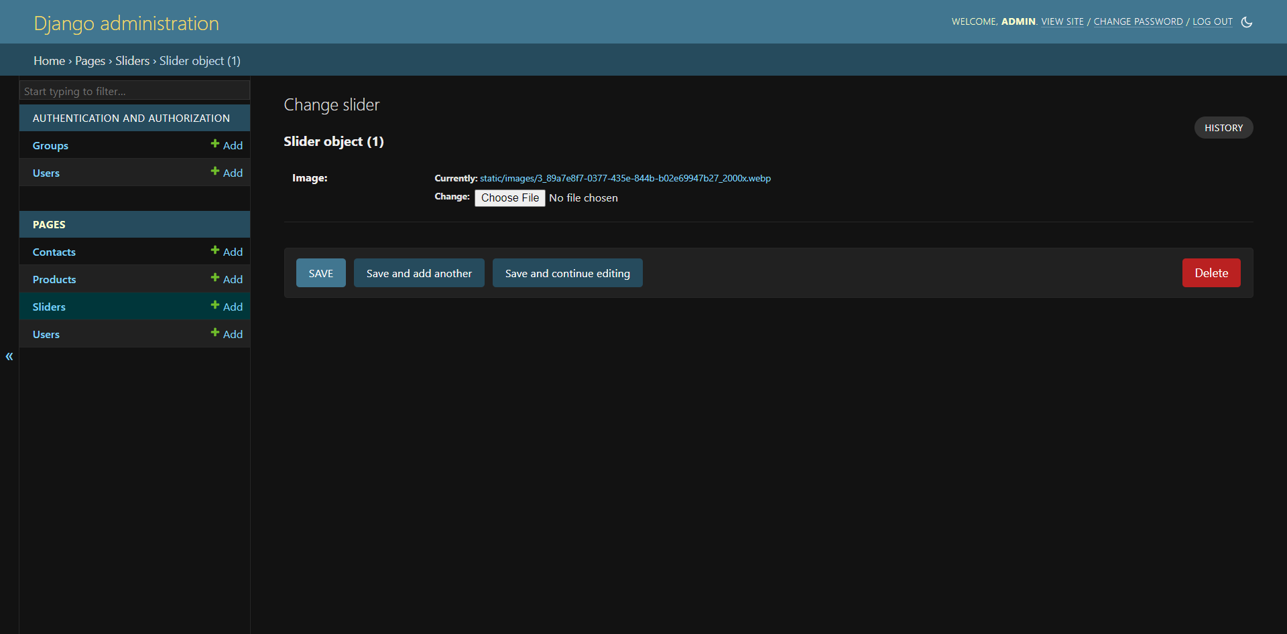
HOME PAGE SLIDER

Slide 21
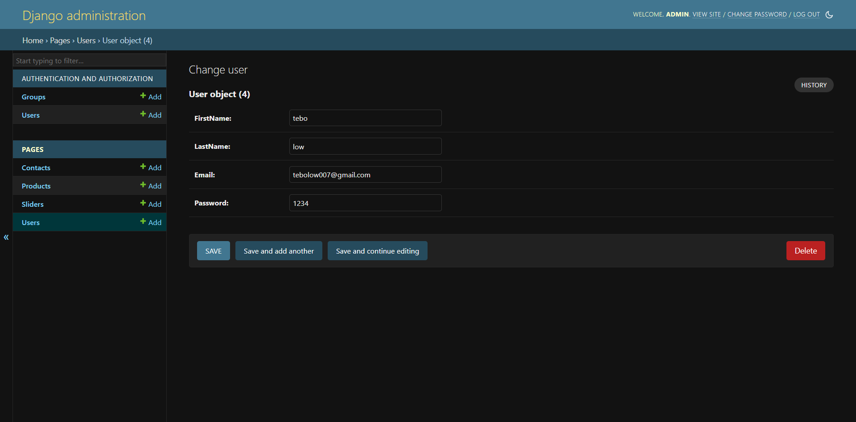
USERS TABLE

Slide 22
UI (USER INTERFACE)

Slide 23
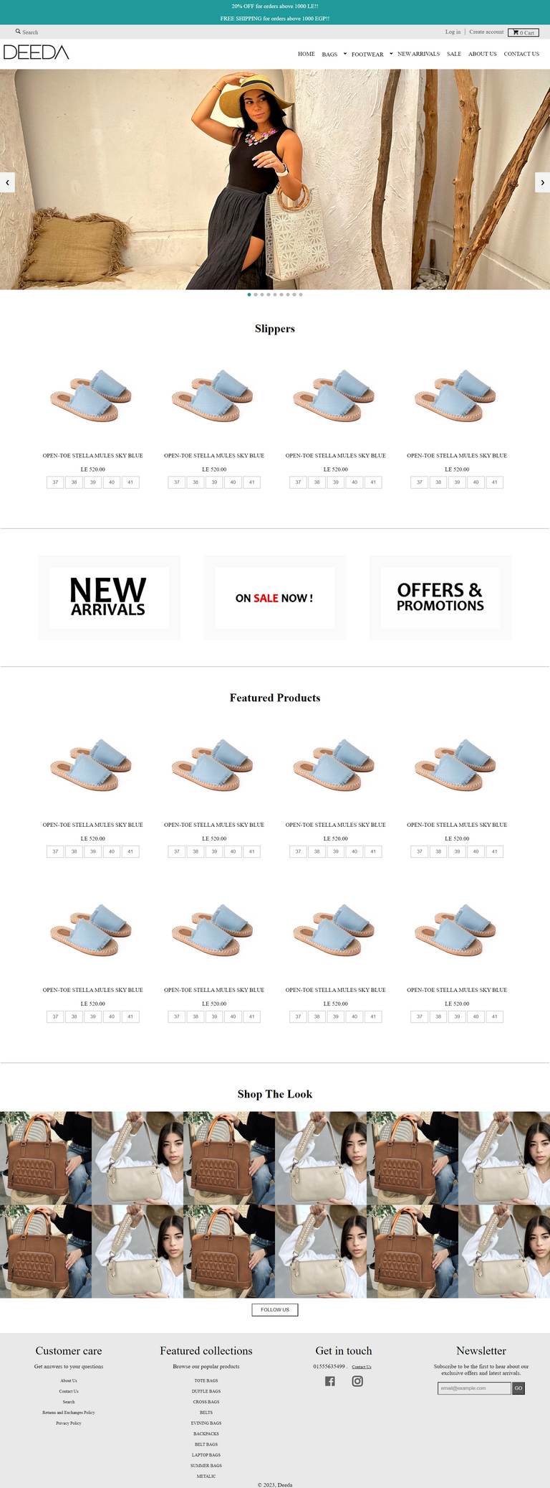
HOME PAGE

Slide 24
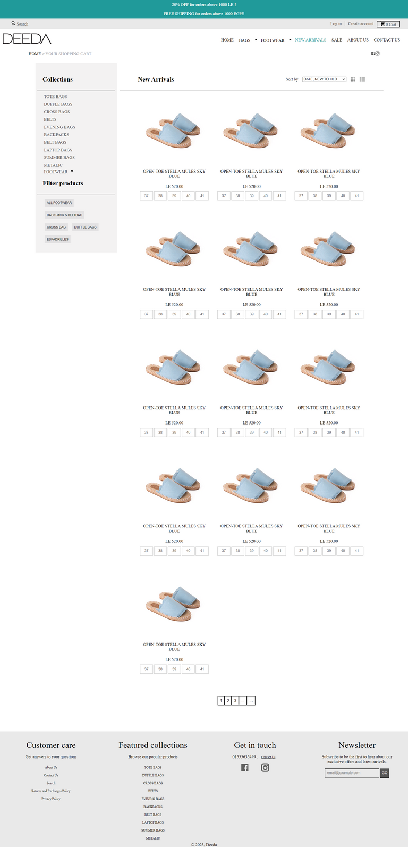
ALL PAGE

Slide 25
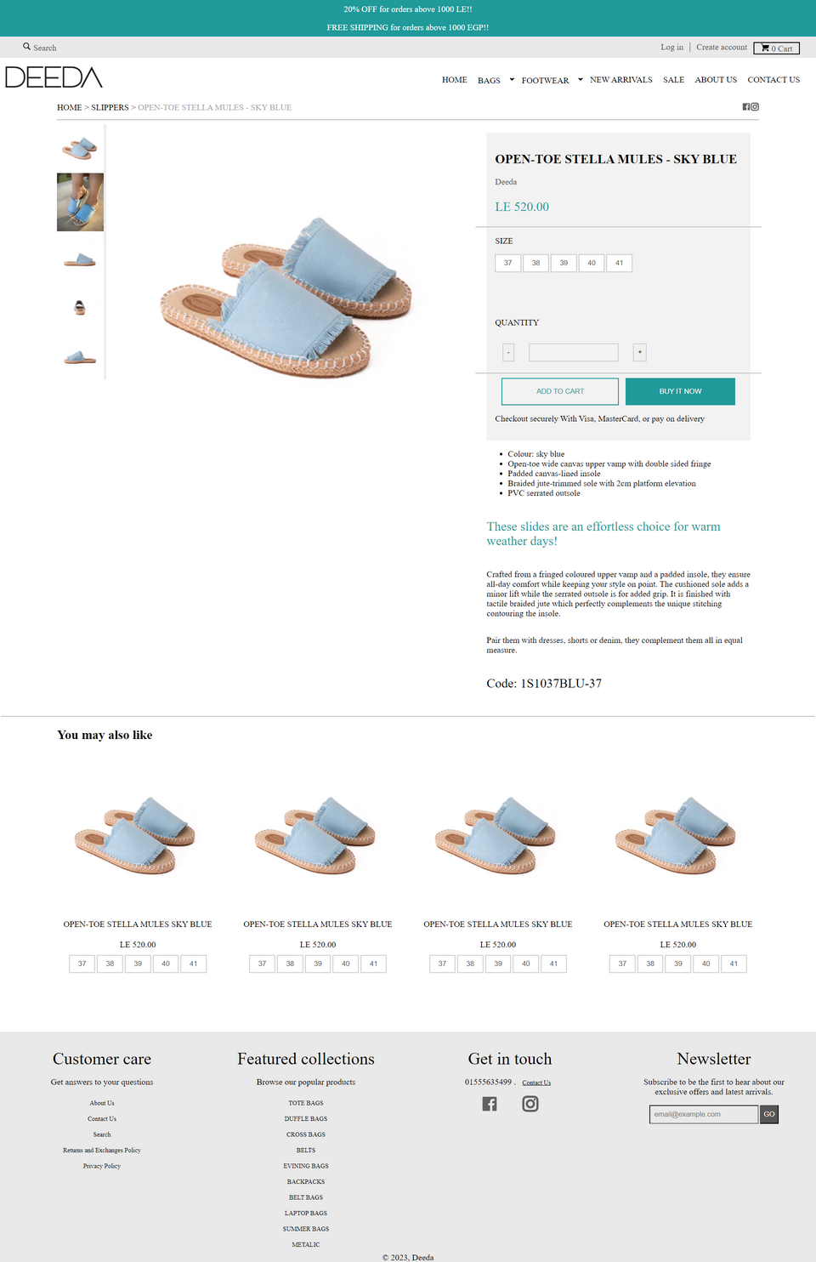
PRODUCT PAGE

Slide 26
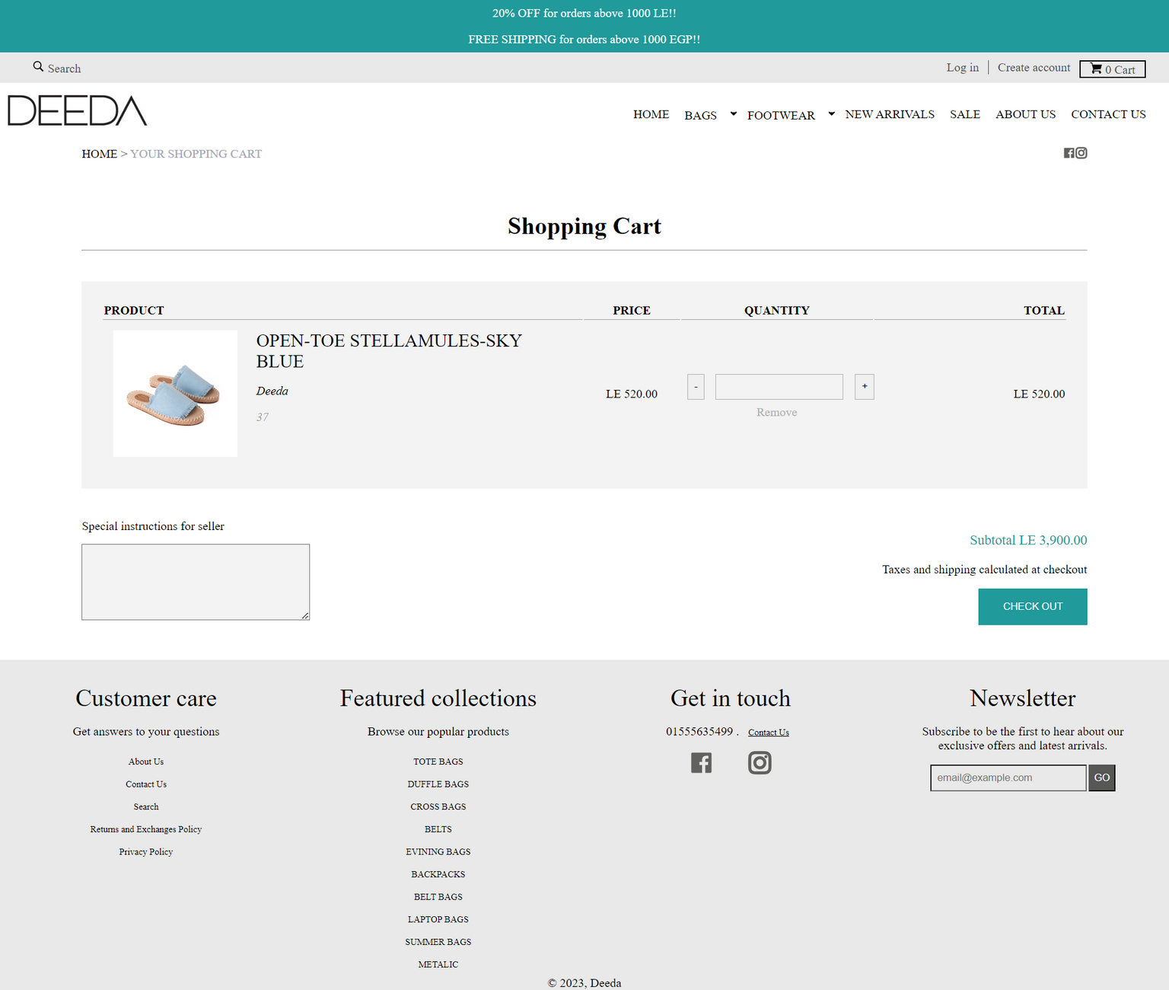
CART
PAGE

Slide 27
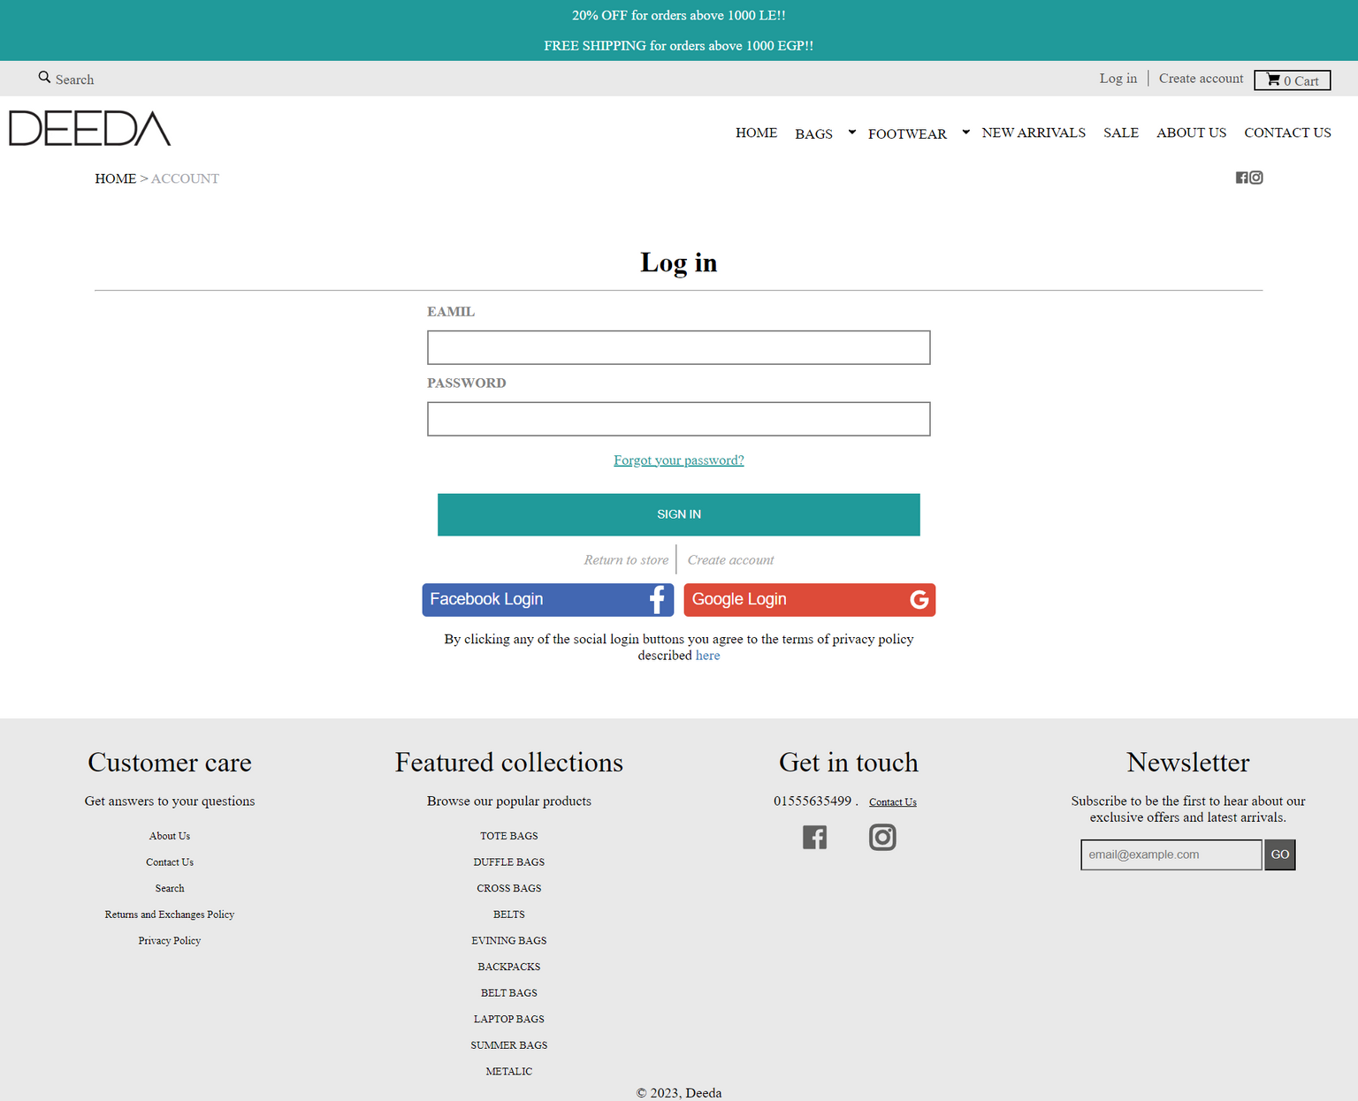
LOG
IN
PAGE

Slide 28
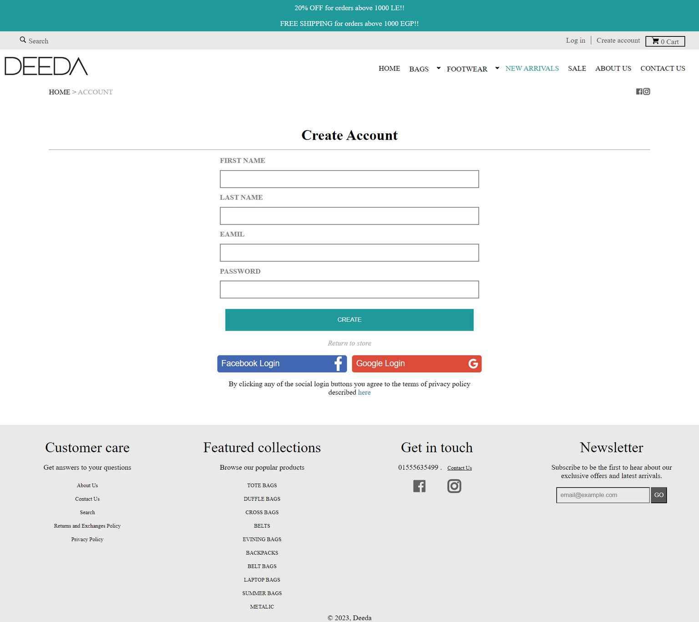
REGISTER
PAGE

Slide 29
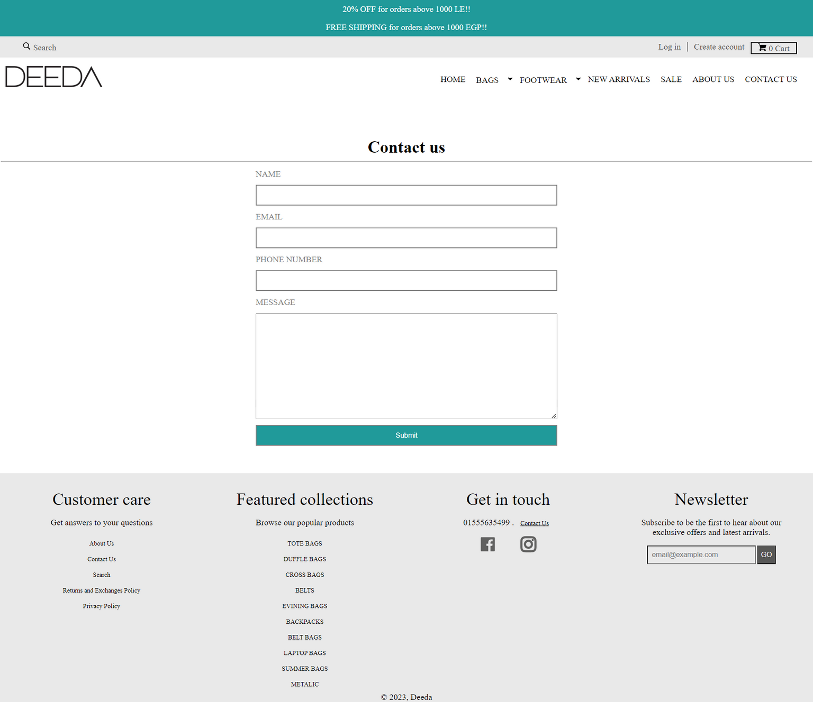
CONTACT
PAGE

Slide 30
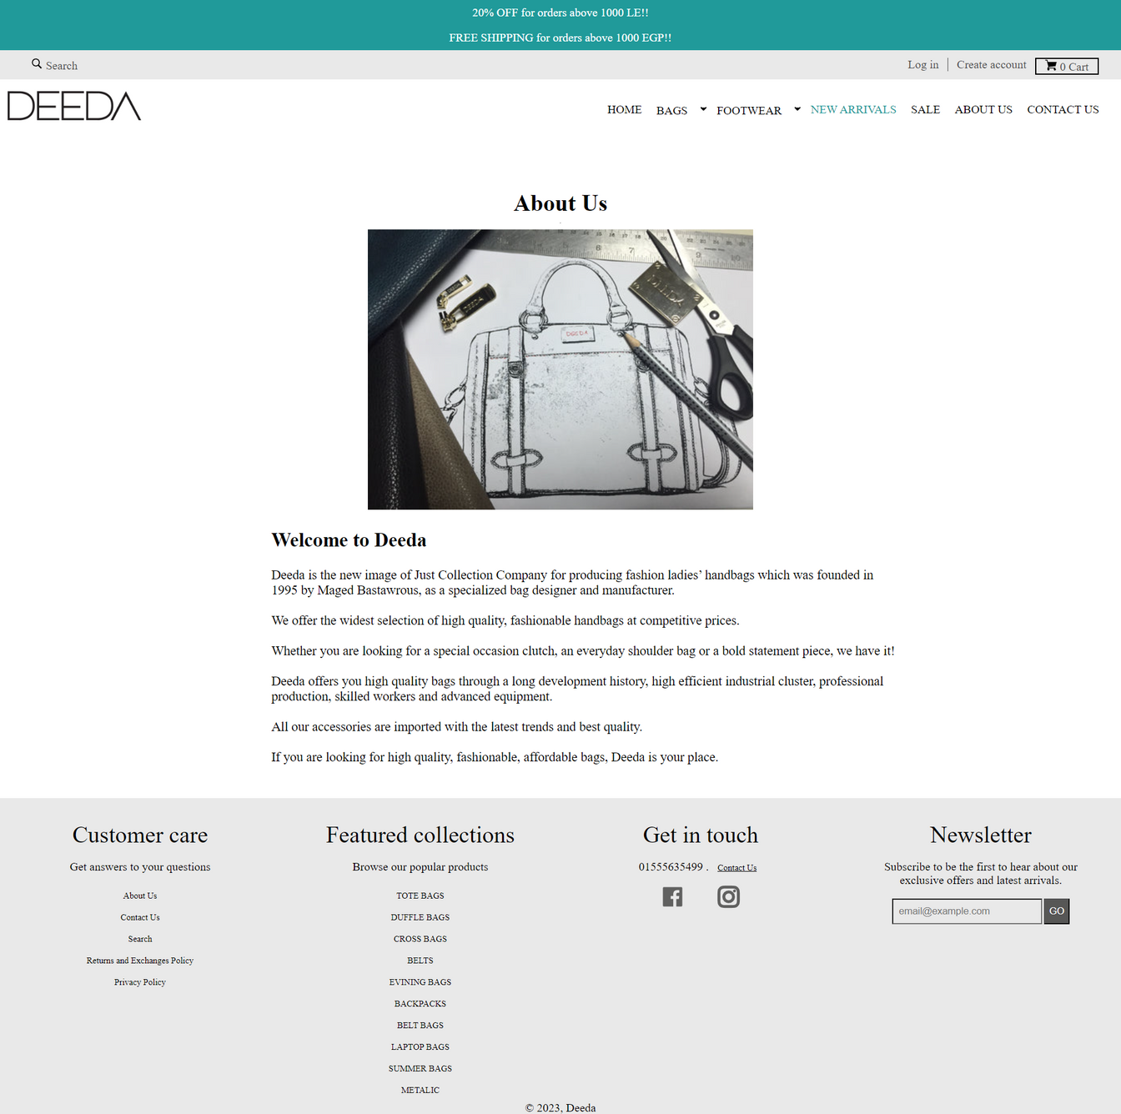
ABOUT PAGE

Slide 31




Thank You.
Ahmed Abdeltwab
+201090573140
aabdeltwab62@gmail.com
www.Ahmed_Abdeltwab.com

